Slide 1

Natural Language Processing
Paul Rad, Ph.D.
Associate Professor
Cyber Analytics and AI
Information Systems and Cyber Security
College of Business School
210.872.7259

Slide 2
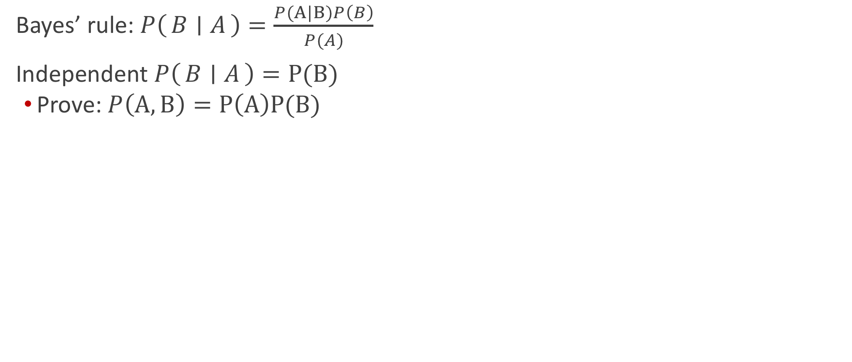
Conditional probability
Bayes’ rule: $P\left(B ∣ A\right)=\frac{P(A|B)P\left(B\right)}{P(A)}$
Independent $P\left(B ∣ A\right)=P(B)$
Prove: $P\left(A,B\right)=P\left(A\right)P(B)$

Slide 3
Idea 1: Taxonomy (Word category)

Slide 4
Idea 2: Similarity = Clustering

Slide 5
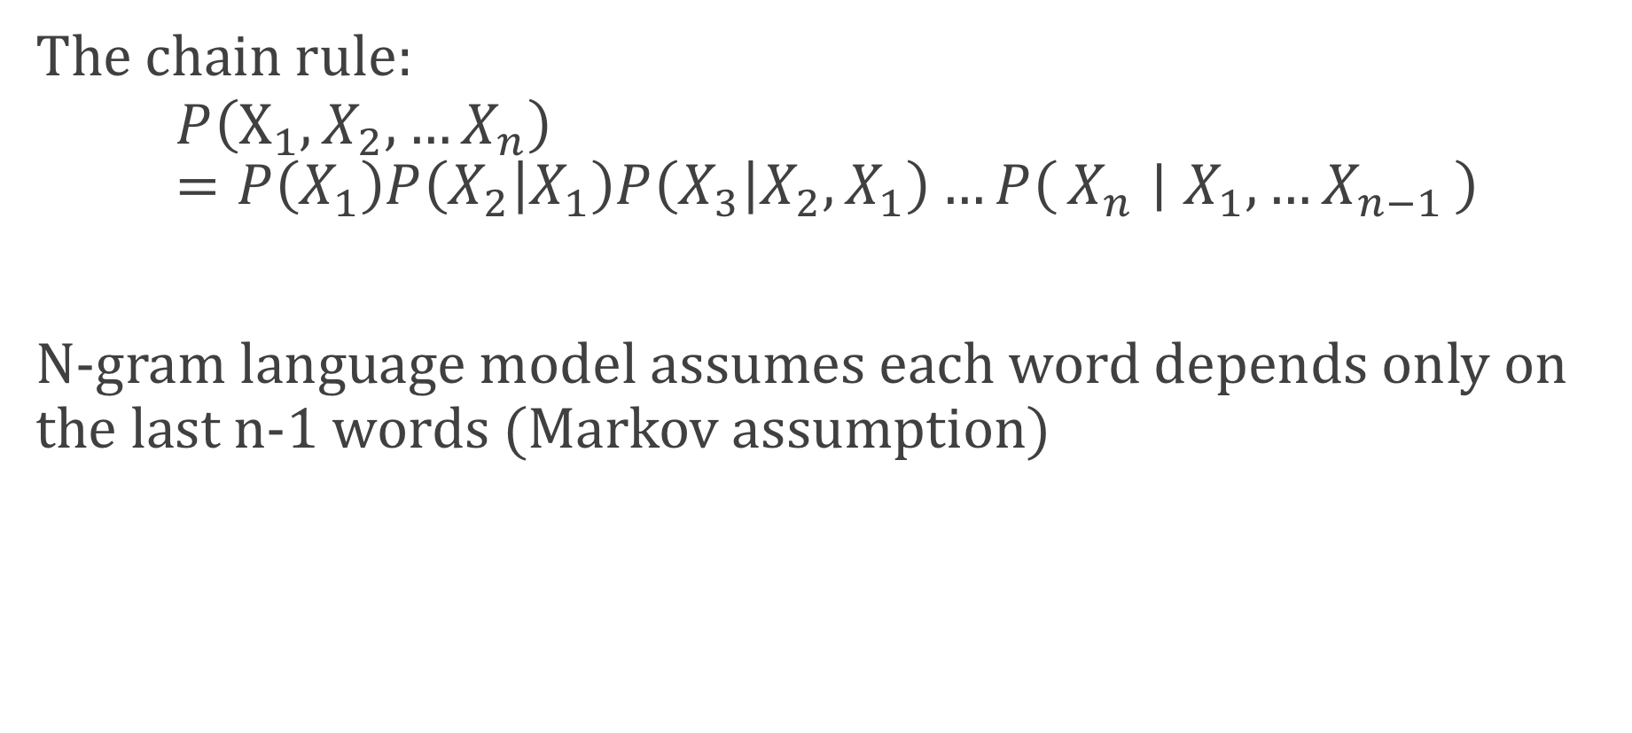
Language model with N-gram
The chain rule:
$$P\left(X_{1},X_{2},…X_{n}\right)=P\left(X_{1}\right)P\left(X_{2} | X_{1}\right)P\left(X_{3} | X_{2},X_{1}\right)…P\left(X_{n} ∣ X_{1},…X_{n−1}\right)$$
N-gram language model assumes each word depends only on the last n-1 words (Markov assumption)

Slide 6
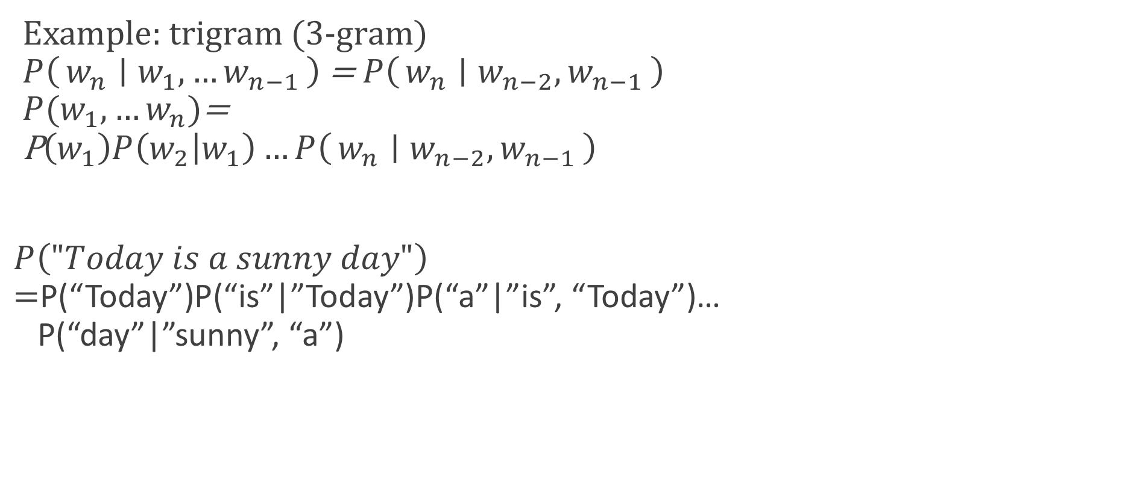
Language model with N-gram
Example: trigram (3-gram) $P\left(w_{n} ∣ w_{1},…w_{n−1}\right)$ = $P\left(w_{n} ∣ w_{n−2},w_{n−1}\right)$ $P(w_{1}, …w_{n})$= P$\left(w_{1}\right)P\left(w_{2} | w_{1}\right)…P\left(w_{n} ∣ w_{n−2},w_{n−1}\right)$
$P\left("Today is a sunny day"\right)$ $=$P(“Today”)P(“is”|”Today”)P(“a”|”is”, “Today”)… P(“day”|”sunny”, “a”)

Slide 7
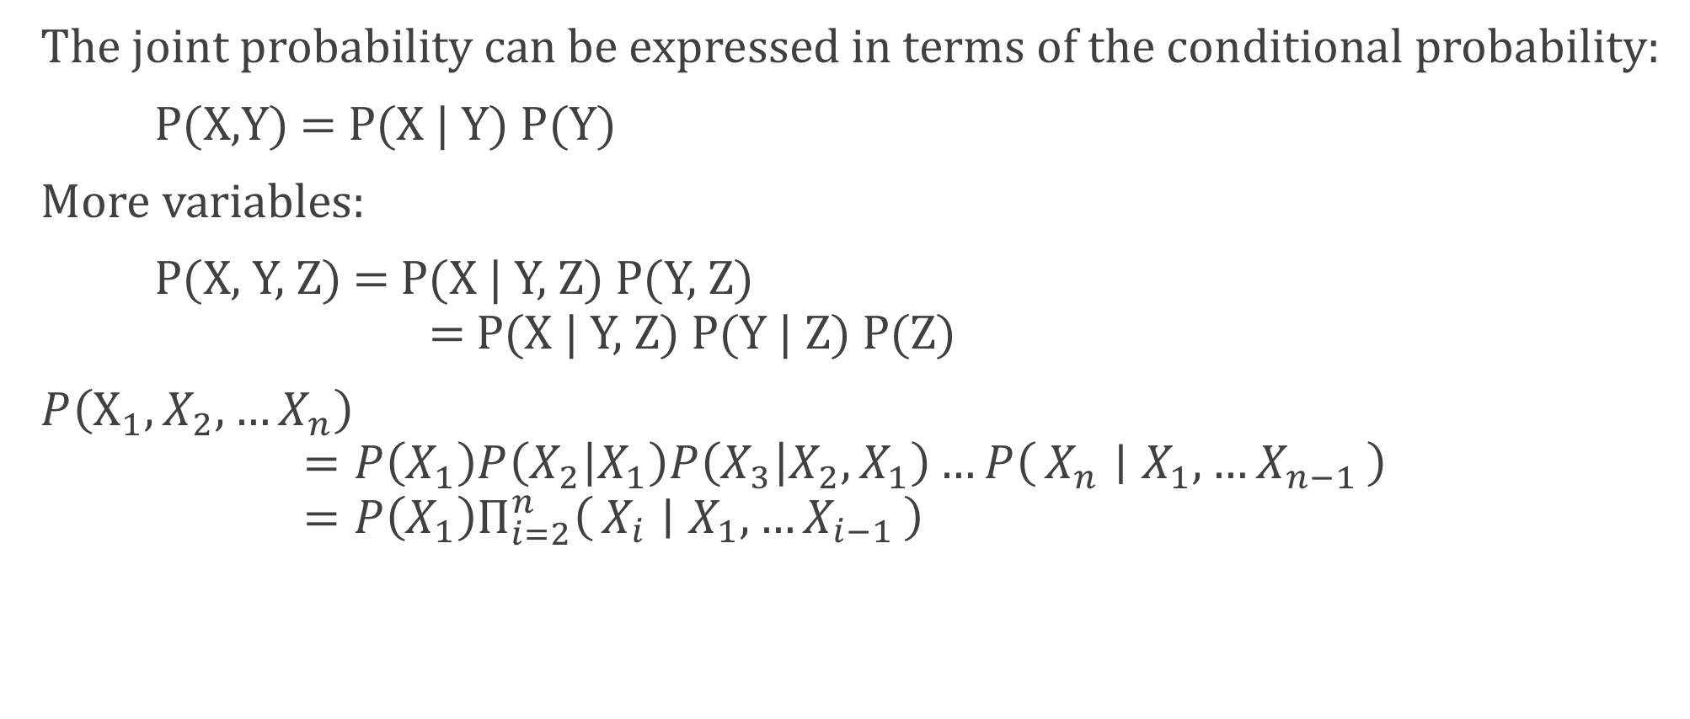
The Chain Rule
The joint probability can be expressed in terms of the conditional probability:
P(X,Y) = P(X | Y) P(Y)
More variables:
P(X, Y, Z) = P(X | Y, Z) P(Y, Z) = P(X | Y, Z) P(Y | Z) P(Z)
$P\left(X_{1},X_{2},…X_{n}\right)$ $=P\left(X_{1}\right)P\left(X_{2} | X_{1}\right)P\left(X_{3} | X_{2},X_{1}\right)…P\left(X_{n} ∣ X_{1},…X_{n−1}\right)$ $=P\left(X_{1}\right)Π_{i=2}^{n}\left(X_{i} ∣ X_{1},…X_{i−1}\right)$

Slide 8
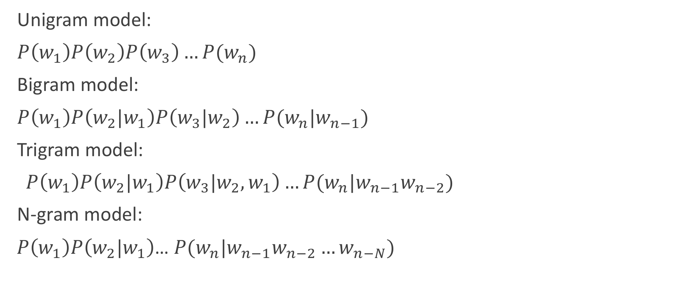
N-Gram Models
Unigram model:
$P\left(w_{1}\right)P\left(w_{2}\right)P\left(w_{3}\right)…P(w_{n})$
Bigram model:
$P\left(w_{1}\right)P\left(w_{2}|w_{1}\right)P\left(w_{3}|w_{2}\right)…P(w_{n}|w_{n−1})$
Trigram model:
$P\left(w_{1}\right)P\left(w_{2}|w_{1}\right)P\left(w_{3}|w_{2},w_{1}\right)…P(w_{n}|w_{n−1}w_{n−2})$
N-gram model:
$P\left(w_{1}\right)P\left(w_{2}|w_{1}\right)$… $P(w_{n}|w_{n−1}w_{n−2}…w_{n−N})$

Slide 9
Unigram model

Slide 10
Bigram model
Condition on the previous word

Slide 11
Recap: Bigram language model
Let P(<S>) = 1
P( I | <S>) = 2 / 3 P(am | I) = 1
P( Sam | am) = 1/3 P( </S> | Sam) = 1/2
P( <S> I am Sam</S>) = 1*2/3*1*1/3*1/2
<S> I am Sam </S>
<S> I am legend </S>
<S> Sam I am </S>

Slide 12
Vector Space Model
https://www.nltk.org

Slide 13
This lecture
How to represent a word, a sentence, or a document?
How to infer the relationship among words?
We focus on “semantics”: distributional semantics

Slide 14
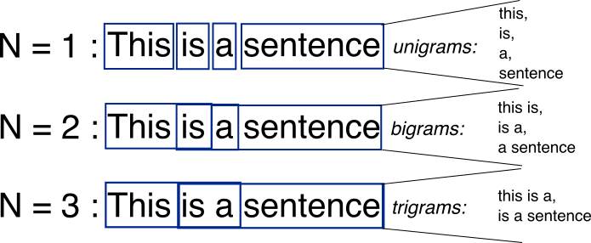
Bag-of-Words with N-grams
N-grams: a contiguous sequence of n tokens from a given piece of text
N-(N-grams -1)
http://recognize-speech.com/language-model/n-gram-model/comparison

Slide 15
Probability Distribution

Slide 16
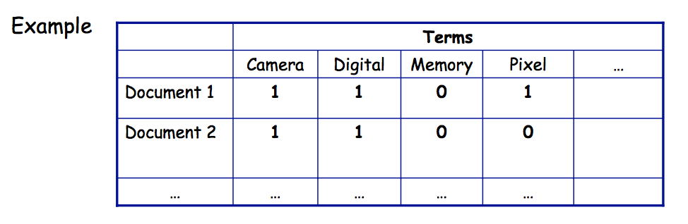
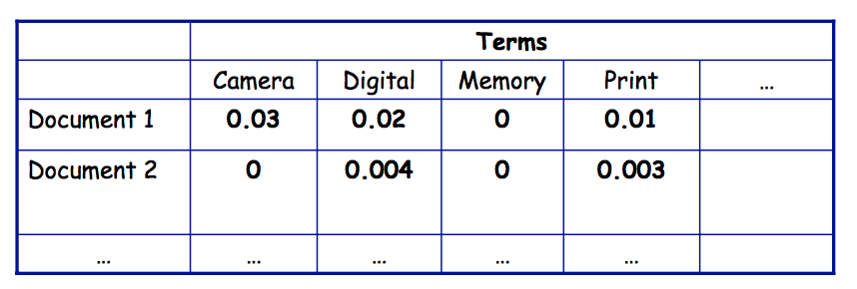
Document Representation
A document representation aims to capture what the document Document Representation Another approach: is about.
One possible approach:
Each entry describes a document
Attribute describe whether or not a term appears in the in the document Example: Term frequency table document
Another approach:
Attributes represent the frequency in which a term appears in the document

Slide 17
More on Document Representation
Stop Word removal:
Stemming: reducing words to their root form
A document may contain several occurrences of words like fish, fishes, fisher, and fishers
But would not be retrieved by a query with the keyword fishing
Different words share the same word stem and should be represented with its stem, instead of the actual word

Slide 18
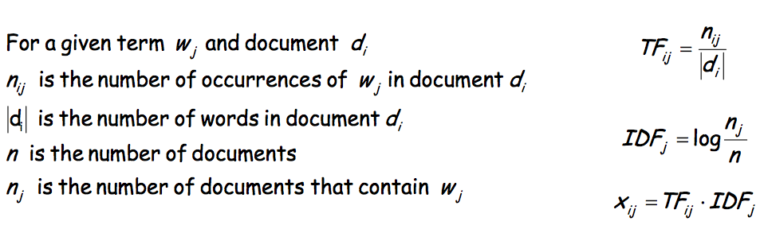
Term Frequencies
TF-IDF weighting: give higher weight to terms that are rare
TF: term frequency (increases weight of frequent terms)
If a term is frequent in lots of documents it does not have discriminative power
IDF: inverse term frequency

Slide 19
Clustering Method
K-nearest neighbors
Training examples are points in a vector space
Compute distance between new instance and all training instances and the k-closest vote for the class
Singular Value Decomposition
Classification using Neural Network

Slide 20
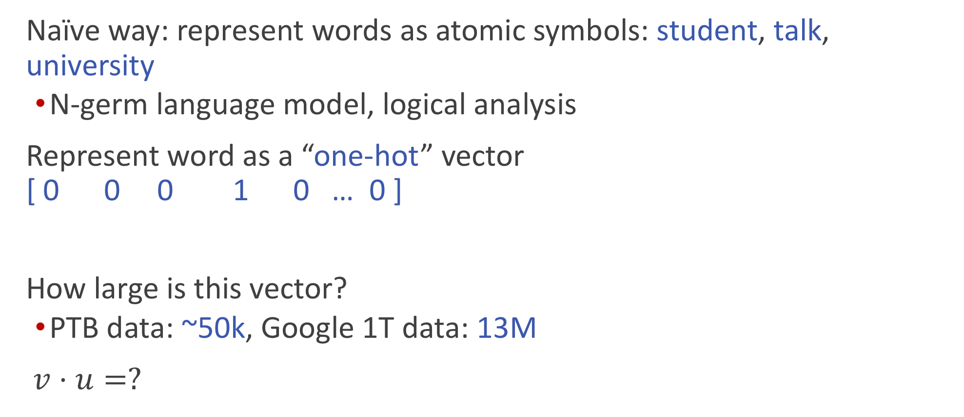
How to represent a word (word embedding)
Naïve way: represent words as atomic symbols: student, talk, university
N-germ language model, logical analysis
Represent word as a “one-hot” vector [ 0 0 0 1 0 … 0 ]
How large is this vector?
PTB data: ~50k, Google 1T data: 13M
$v⋅u=?$
egg student talk university happy buy

Slide 21
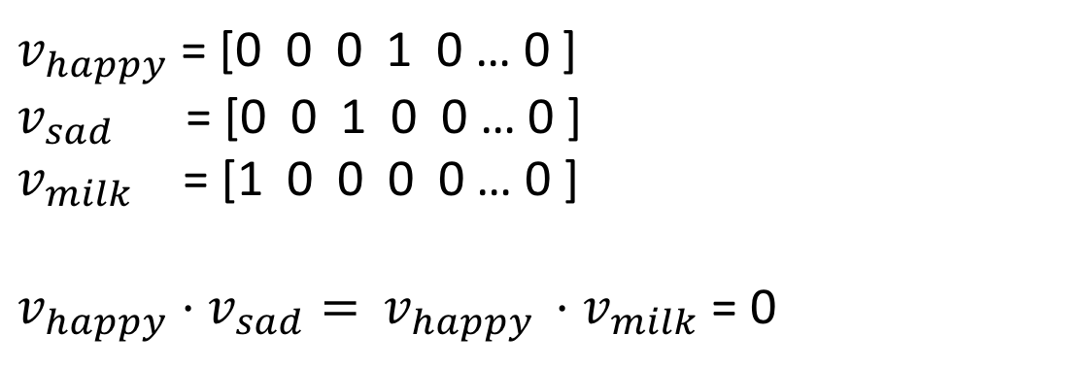
Issues?
Dimensionality is large; vector is sparse
No similarity
Cannot represent new words
Any idea?
$v_{happy}$ = [0 0 0 1 0 … 0 ]
$v_{sad}$= [0 0 1 0 0 … 0 ]
$v_{milk}$ = [1 0 0 0 0 … 0 ]
$v_{happy}⋅$ $v_{sad}=$ $v_{happy }⋅$ $v_{milk}$ = 0

Slide 22
Pre-trained word vectors
Google Book https://code.google.com/archive/p/word2vec
100 billion tokens, 300 dimension, 3M words
Glove project http://nlp.stanford.edu/projects/glove/
Pre-trained word vectors of Wiki (6B), web crawl data (840B), twitter (27B)

Slide 23
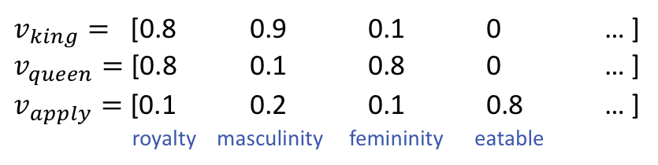
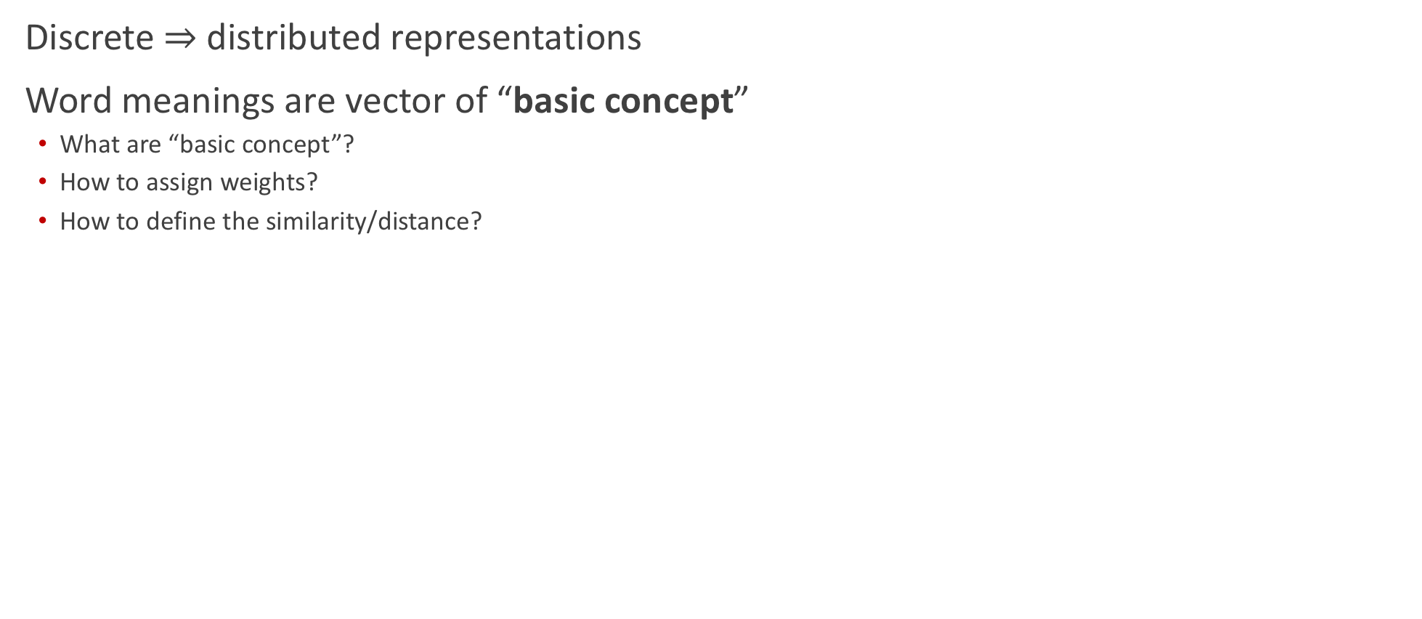
Vector representation
Discrete $⇒$ distributed representations
Word meanings are vector of “basic concept”
What are “basic concept”?
How to assign weights?
How to define the similarity/distance?
$v_{king}=$ [0.8 0.9 0.1 0 … ]
$v_{queen}=$ [0.8 0.1 0.8 0 … ]
$v_{apply}=$ [0.1 0.2 0.1 0.8 … ]
royalty masculinity femininity eatable

Slide 24
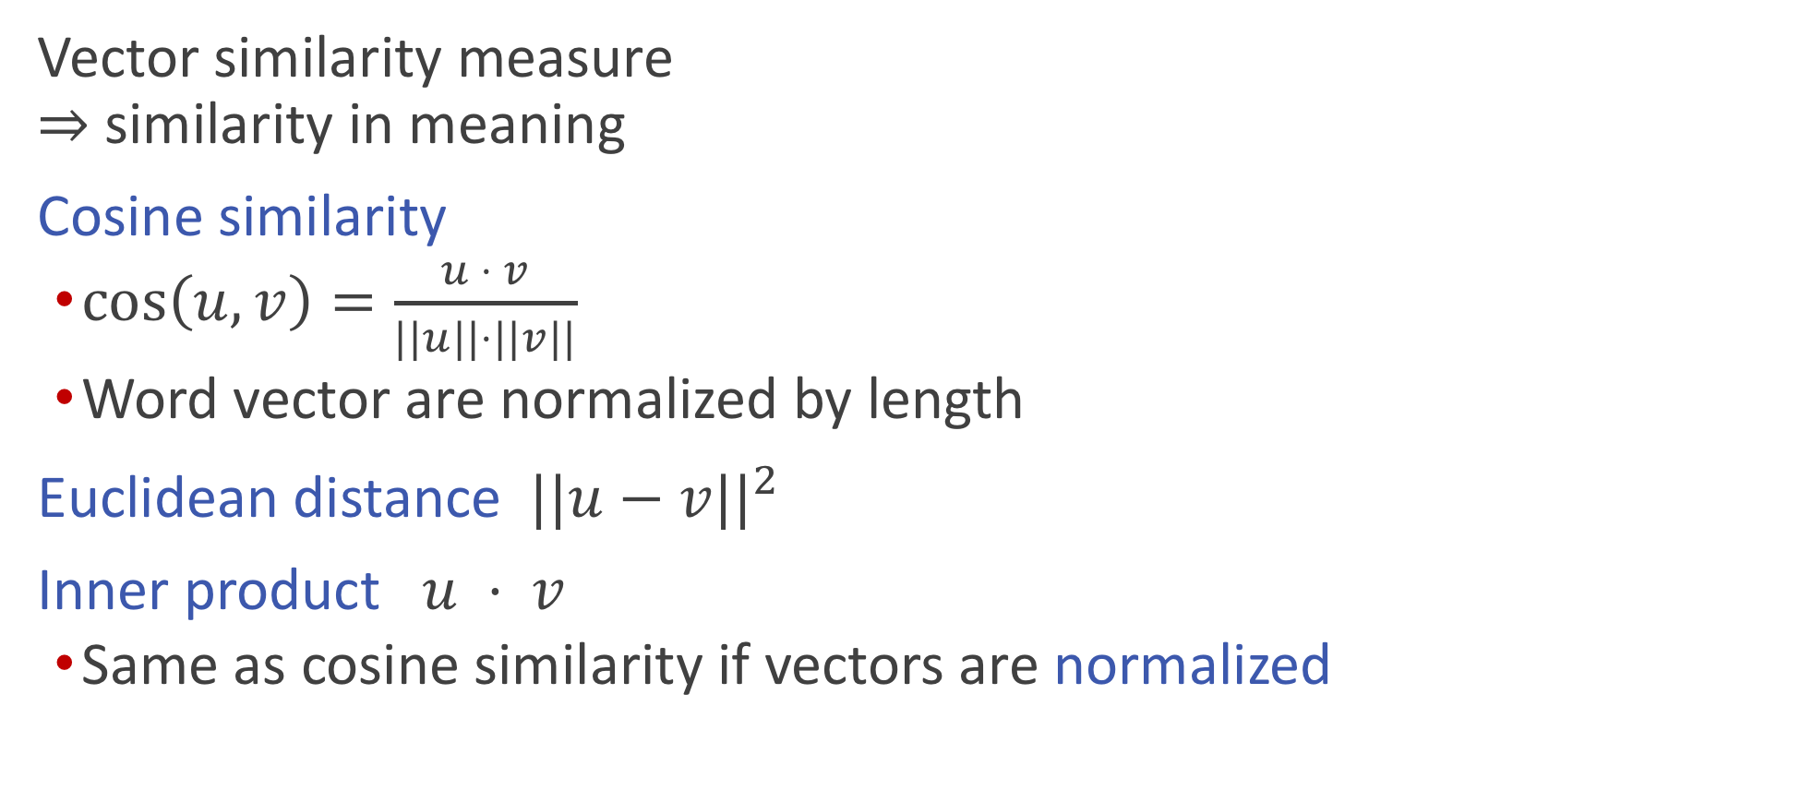
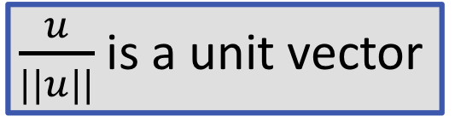
Distance/similarity
Vector similarity measure $⇒$ similarity in meaning
Cosine similarity
$\cos\left(u,v\right)=\frac{u ⋅ v}{||u||⋅||v||}$
Word vector are normalized by length
Euclidean distance $||u−v||^{2}$
Inner product $u ⋅ v$
Same as cosine similarity if vectors are normalized
$\frac{u}{||u||}$ is a unit vector

Slide 25
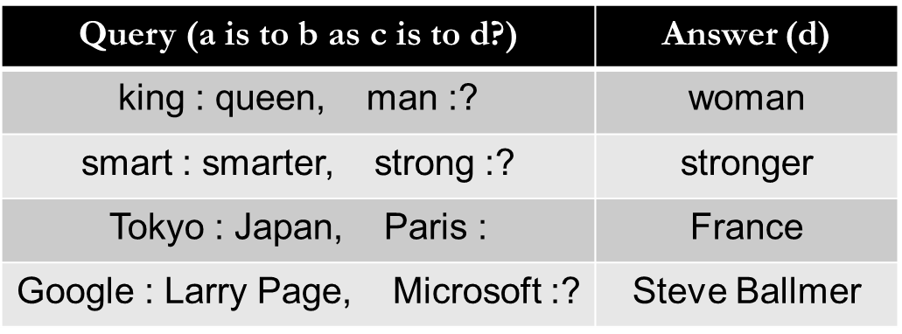
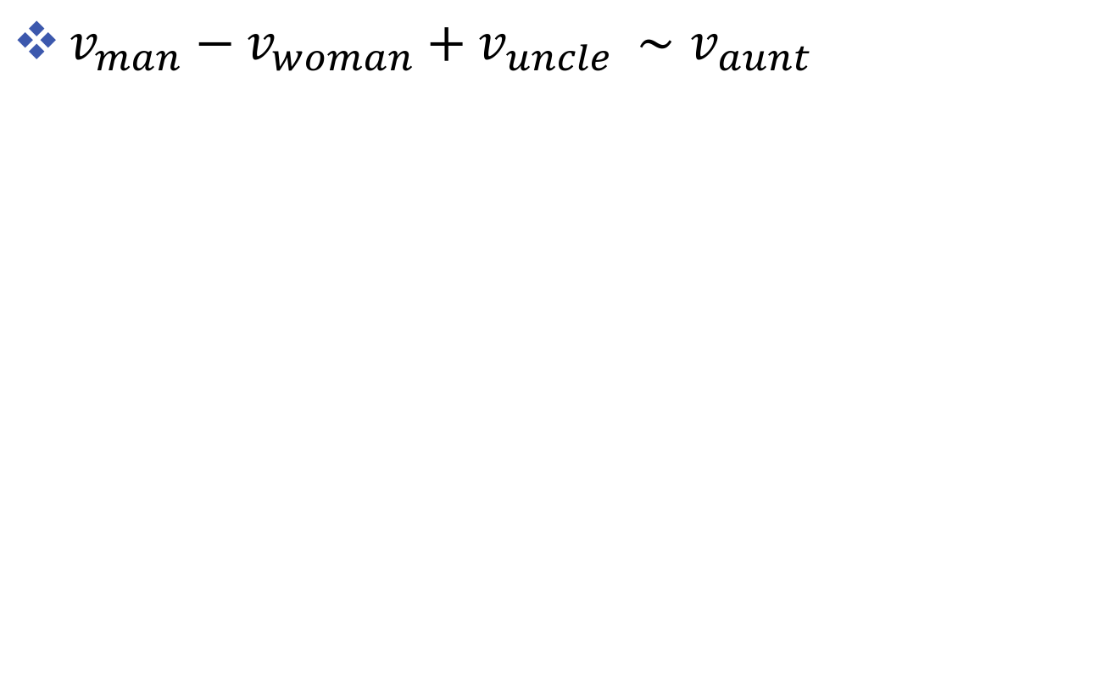
Word analogy
$v_{man}−v_{woman}+v_{uncle }{∼v}_{aunt }$

Slide 26
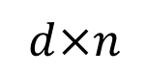
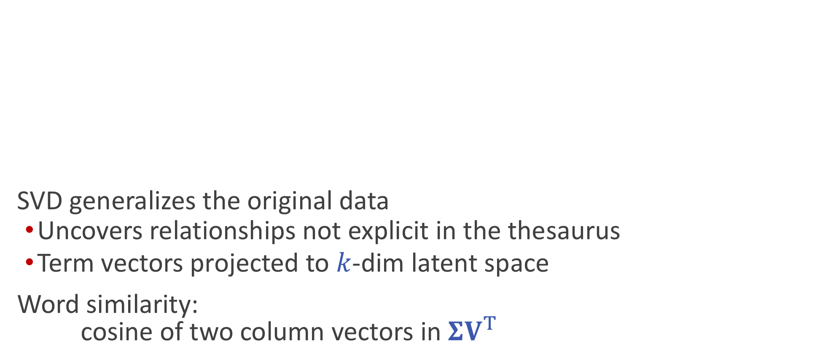


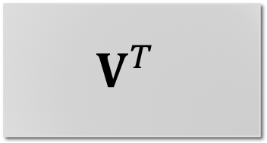
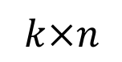

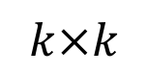

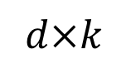
Recap: Mapping to Latent Space via SVD
SVD generalizes the original data
Uncovers relationships not explicit in the thesaurus
Term vectors projected to $k$-dim latent space
Word similarity: cosine of two column vectors in $ΣV^{T}$
$$C$$
$$U$$
$$Σ$$
$$V^{T}$$
$$≈$$
$$k×k$$
$$k×n$$
$$d×n$$
$$d×k$$

Slide 27
Low rank approximation
Low rank approximation problem: $\min_{X}{||C−X||_{F} s.t. rank\left(X\right)=k}$
If I can only use k independent vectors to describe the points in the space, what are the best choices?
Essentially, we minimize the “reconstruction loss” under a low rank constraint

Slide 28
Latent Semantic Analysis (LSA)
Data representation
Encode single-relational data in a matrix
Co-occurrence (e.g., document-term matrix, skip-gram)
Synonyms (e.g., from a thesaurus)
Factorization
Apply SVD to the matrix to find latent components

Slide 29
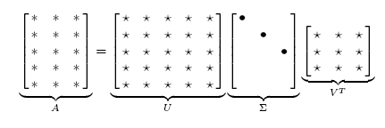
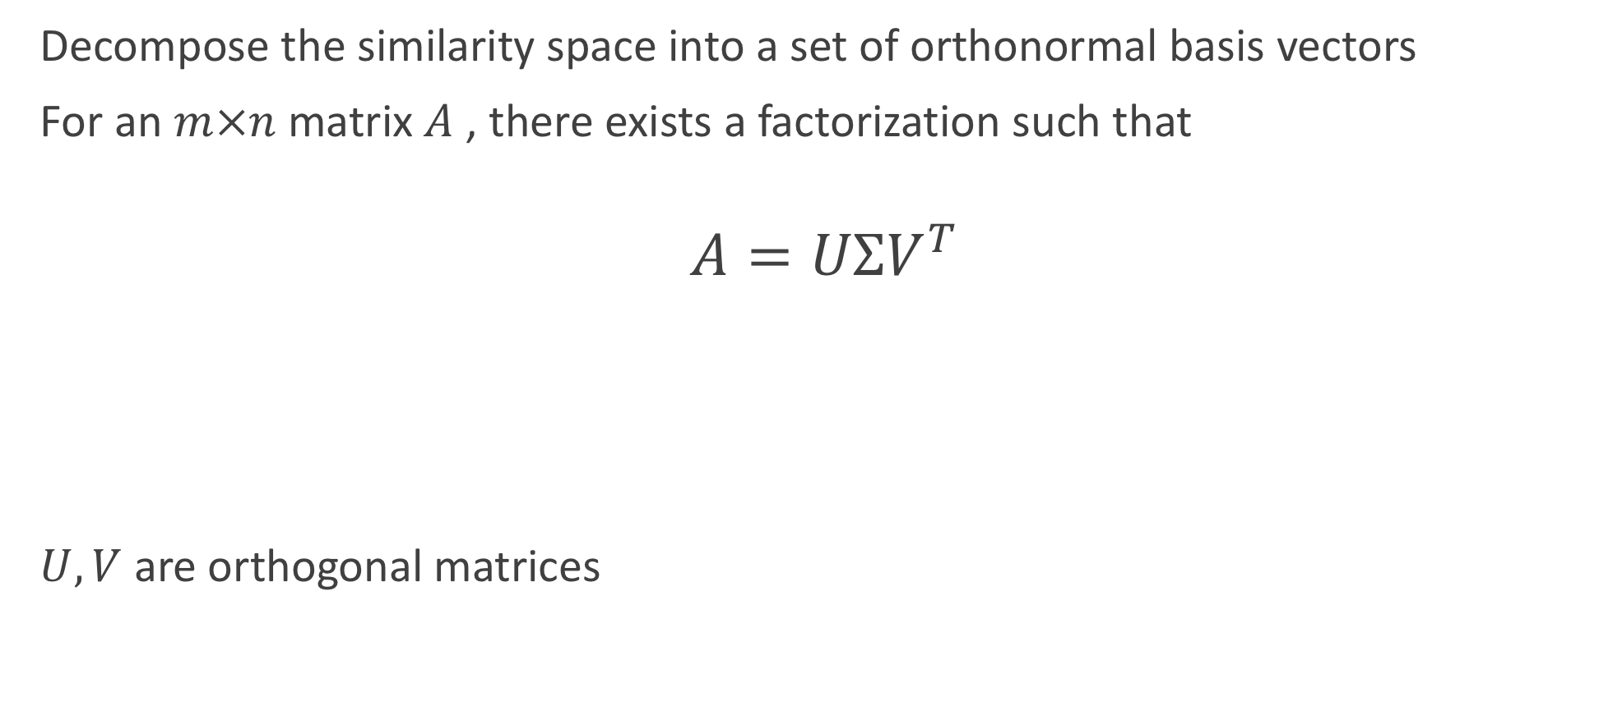
Principle Component Analysis (PCA)
Decompose the similarity space into a set of orthonormal basis vectors
For an $m×n$ matrix $A$ , there exists a factorization such that
$A=UΣV^{T}$
$U, V$ are orthogonal matrices

Slide 30
Principle Component Analysis (PCA)
Decompose the similarity space into a set of orthonormal basis vectors

